Slide 1

R for Research Scientists
Allissa Dillman, PhD
Training Strategist
CIT Cloud Services | STRIDES
Outreach Coordinator
Office of Data Science Strategy

Slide 2


What is
A programming language and open-source software environment that can:
Manipulate data
Visualize
Perform statistics
Free and relatively easy to run in any environment
https://www.r-project.org/

Slide 3
What is RStudio
An Integrated Development Environment (IDE)
Software with R, a graphics viewer, file tracker, code notebook…etc. for interactive one stop shop R coding
https://rstudio.com/

Slide 4
What is Rstudio Cloud
Use Rstudio in a browser, no downloading software
Share projects easily for analysis and teaching
https://rstudio.cloud/

Slide 5
What we will learn today!
A tour of R studio
Basic R commands
Helpful help!
Downloading/loading R packages
Loading data in numerous formats
Making a table
Manipulating/filtering data
Writing data to a file
Visualizing data
Writing graphics to a file

Slide 6
R Script
A text file that contains R code
Can use # to make notes
# is a symbol that is recognized as “skip this line”
There are a couple of more complex flavors that allow code, notes, and visualization
R Notebook
R Markdown
An R Script can be saved and shared
Notes:
We are running all these commands in the script file if we make a mistake we can edit and rerun. We can also make comments using # and it will not get in the way of the code.

Slide 7
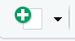
Let’s get started!
You may need to log in to your Rstudio cloud account first
Go to https://rstudio.cloud/
Click log in
https://rstudio.cloud/project/1911826
First click on Save a permanent copy
Click on the new file icon
Select R script

Slide 8
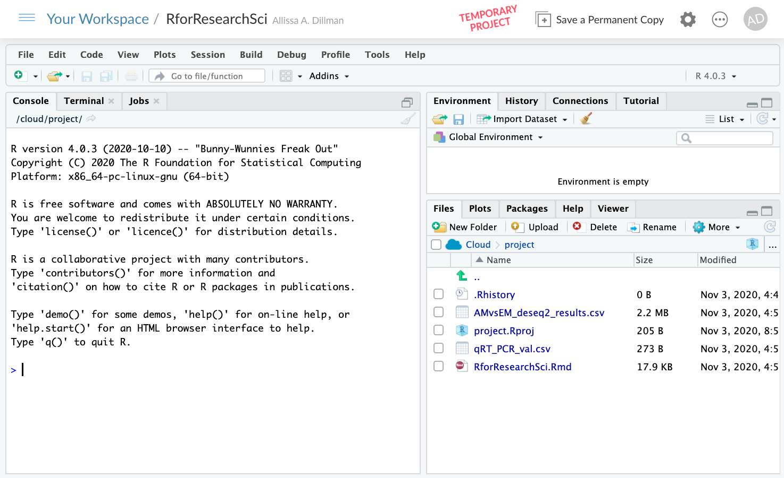
Notes:
Make slide for uploading data

Slide 9
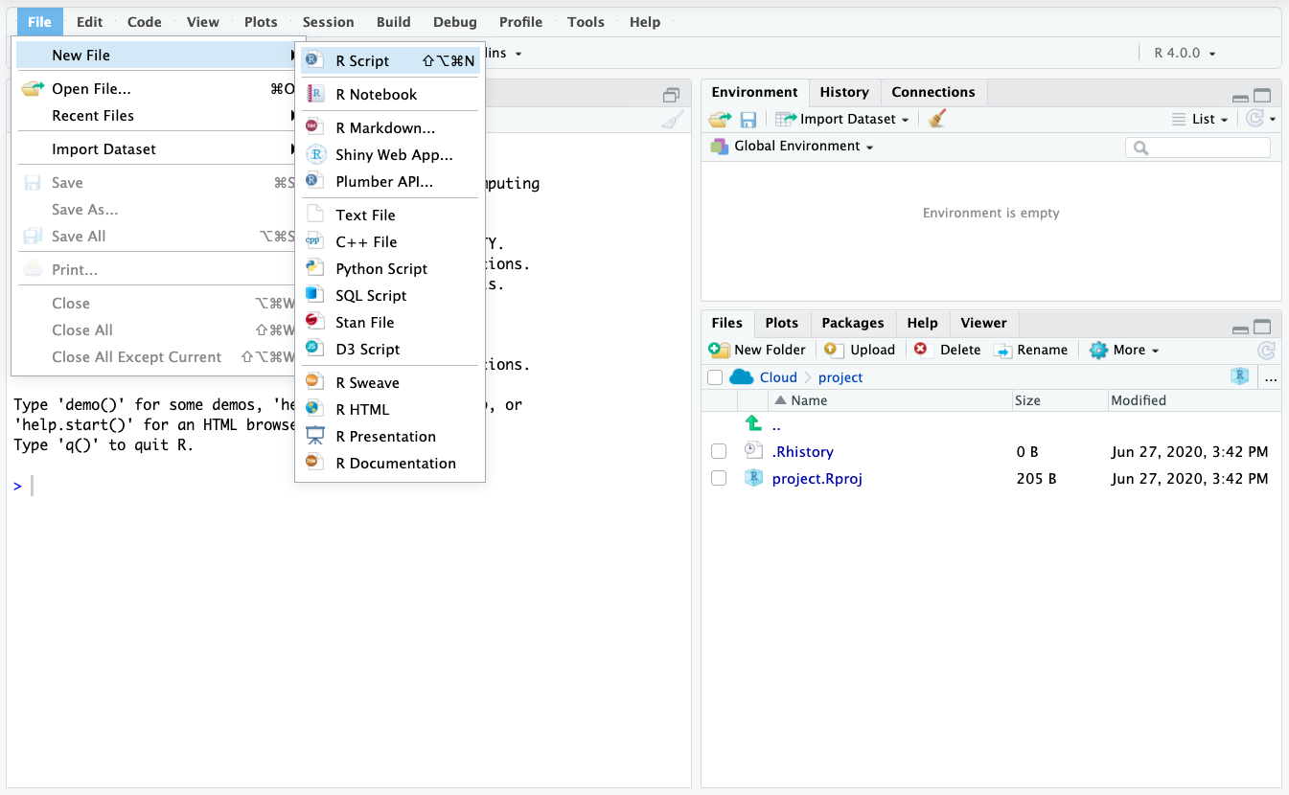
Write code here
Objects go here
Run code here
Written files go here
Notes:
Talk about the various windows console versus script file ect…

Slide 10
R is like a calculator
Enter the following
7+7
a=3
b=5
If I type a it will print out the contents of a which is 3
a+b
a-b
a*b
a/b
Notes:
We are running all these commands in the script file if we make a mistake we can edit and rerun. We can also make comments using # and it will not get in the way of the code.

Slide 11
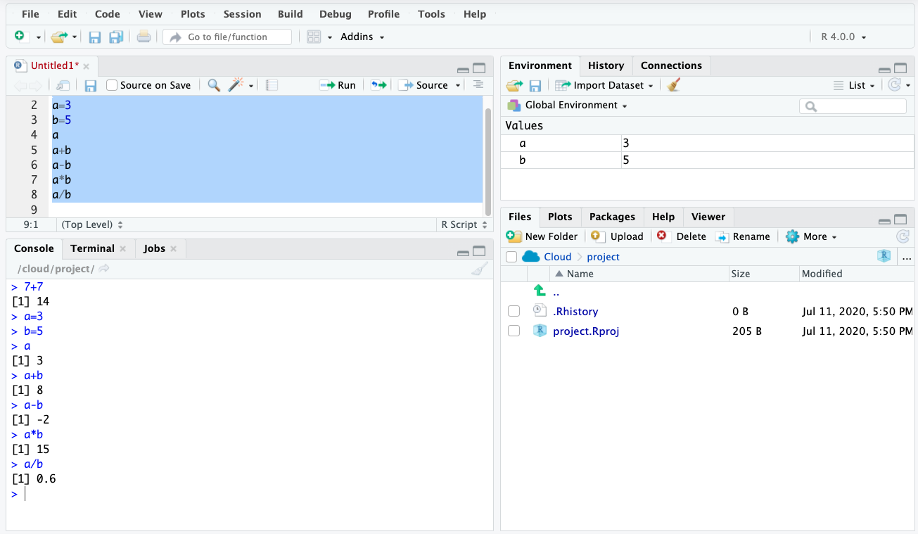
Highlight the section of code you want to run then click run
Temp memory objects

Slide 12
Make a Vector
Vectors are a data structure in R
-list of characters
-list of numbers
-has to be same data type
Use the c() command to enter a bunch of numbers together
Don’t know how to use it?
Type : ?c
Notes:
C is short for combine

Slide 13
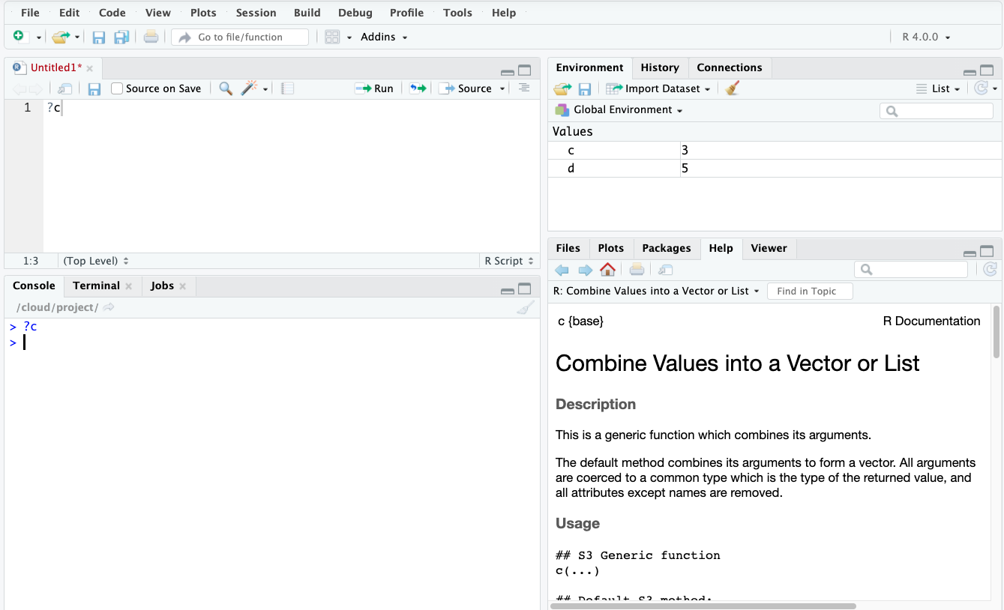

Slide 14
Typing ?
Typing “?” then the command name will give you help on the command name
Typically the bottom of the section will have examples that you can try
Now let's use the c() command
c(5,6,7,8)
This just prints the output to the screen

Slide 15
Create an object
We can create an object for R to keep in its temporary memory
We will assign a name to the vector we used before
Type "d <-" in front of c(5,6,7,8) : d <- c(5,6,7,8)
We created an R object called “d” that is a vector of 5,6,7,8
Keyboard shortcut for <-
-PC: Alt and - at the same time
-Mac: option and - at the same time
Notes:
https://support.rstudio.com/hc/en-us/articles/200711853-Keyboard-Shortcuts

Slide 16
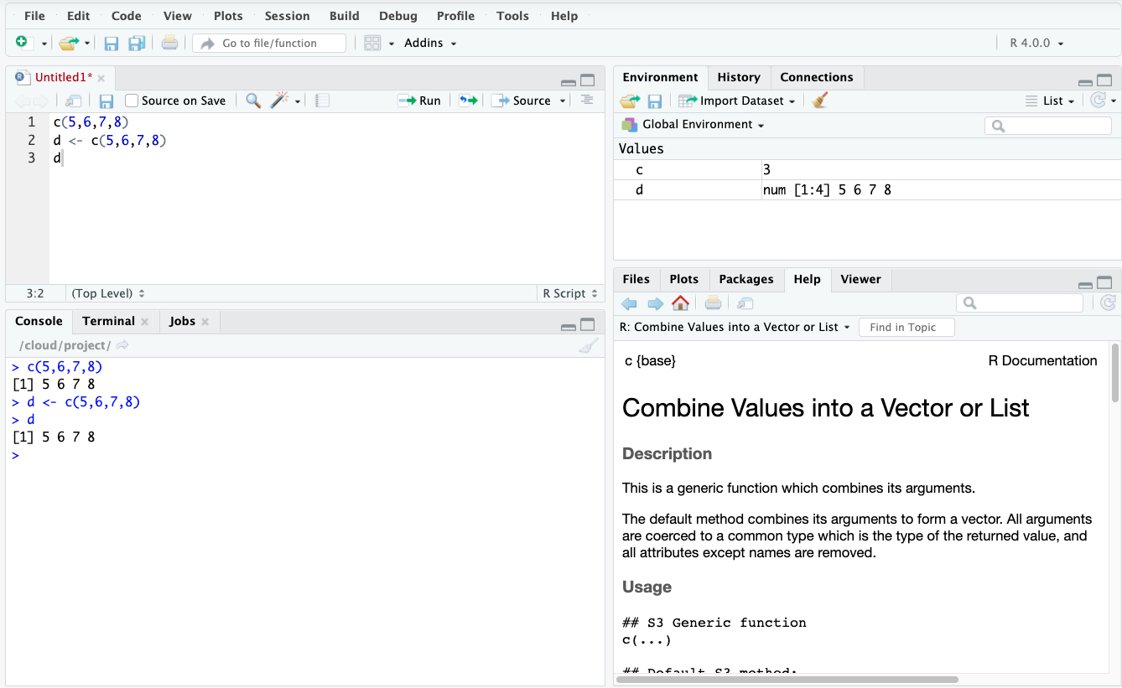

Slide 17
Make more vectors
e <- c(11,12,13,15)
f <- c(1,2,3,4)
g <- c(1,2,3,15)

Slide 18
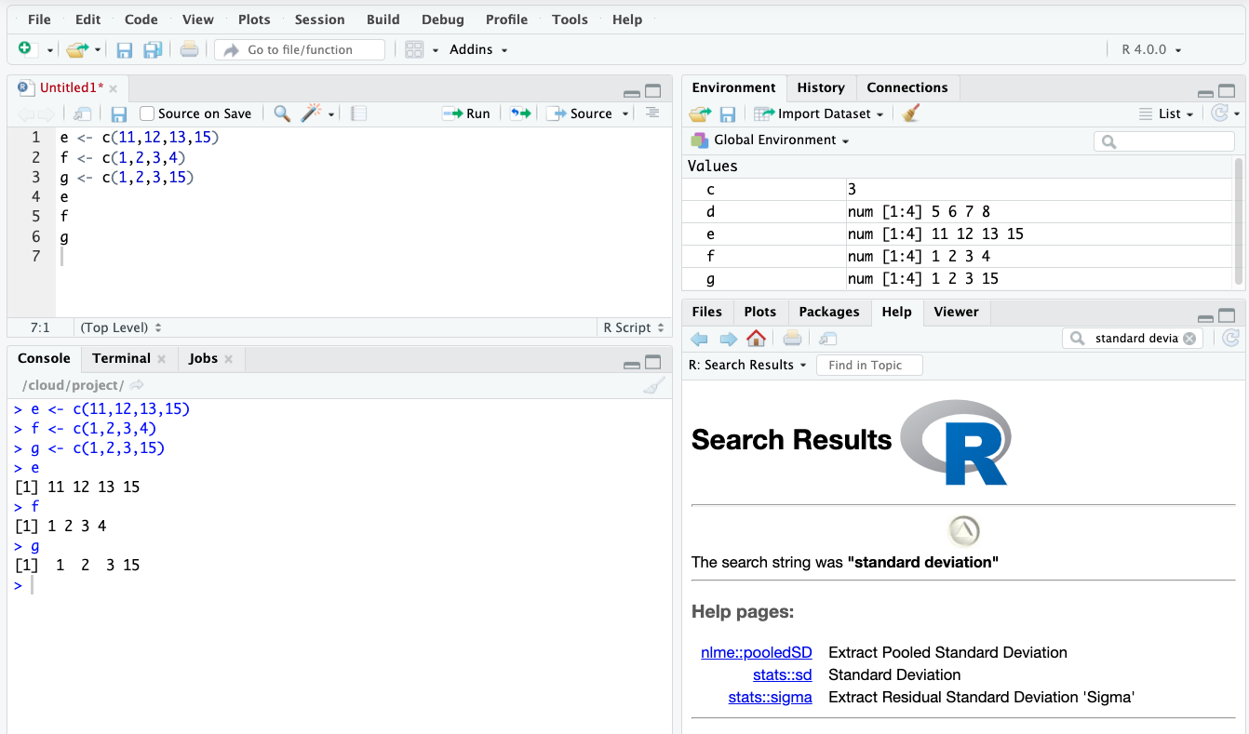

Slide 19
Perform Vector Calculations
d+e
d*e
f-g
f/g

Slide 20
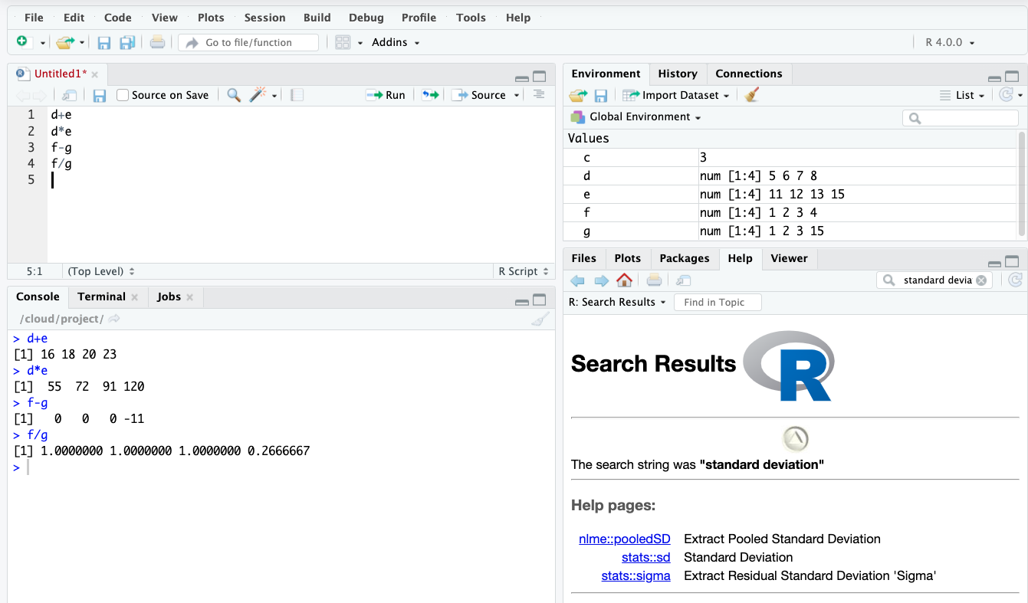

Slide 21
Combine Vectors
h <- c(d,e)
h <-rbind(d,e)
h <- cbind(d,e)

Slide 22
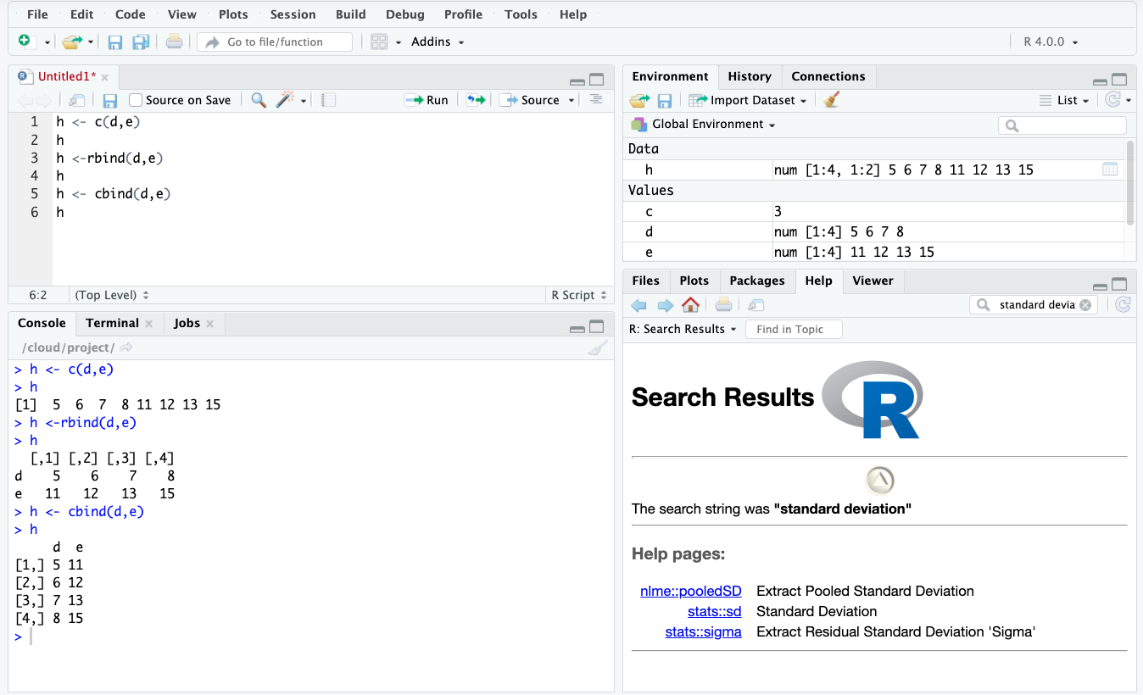

Slide 23
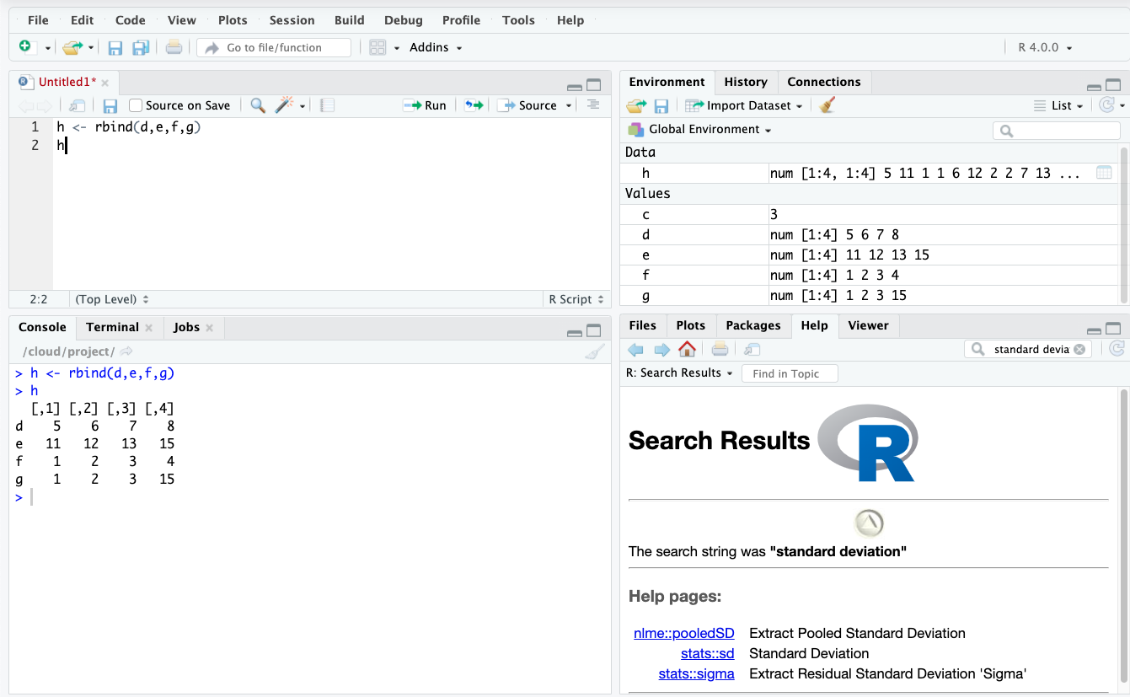
Let's Make a Data Table!
h <- rbind(d,e,f,g)

Slide 24
Column and Row Names
Independent of the data
Makes it easier to work with data later
colnames
rownames
Type the following:
colnames(h) <- c("Col1","Col2","Col3","Col4")
rownames(h) <- c("Row1","Row2","Row3","Row4")

Slide 25
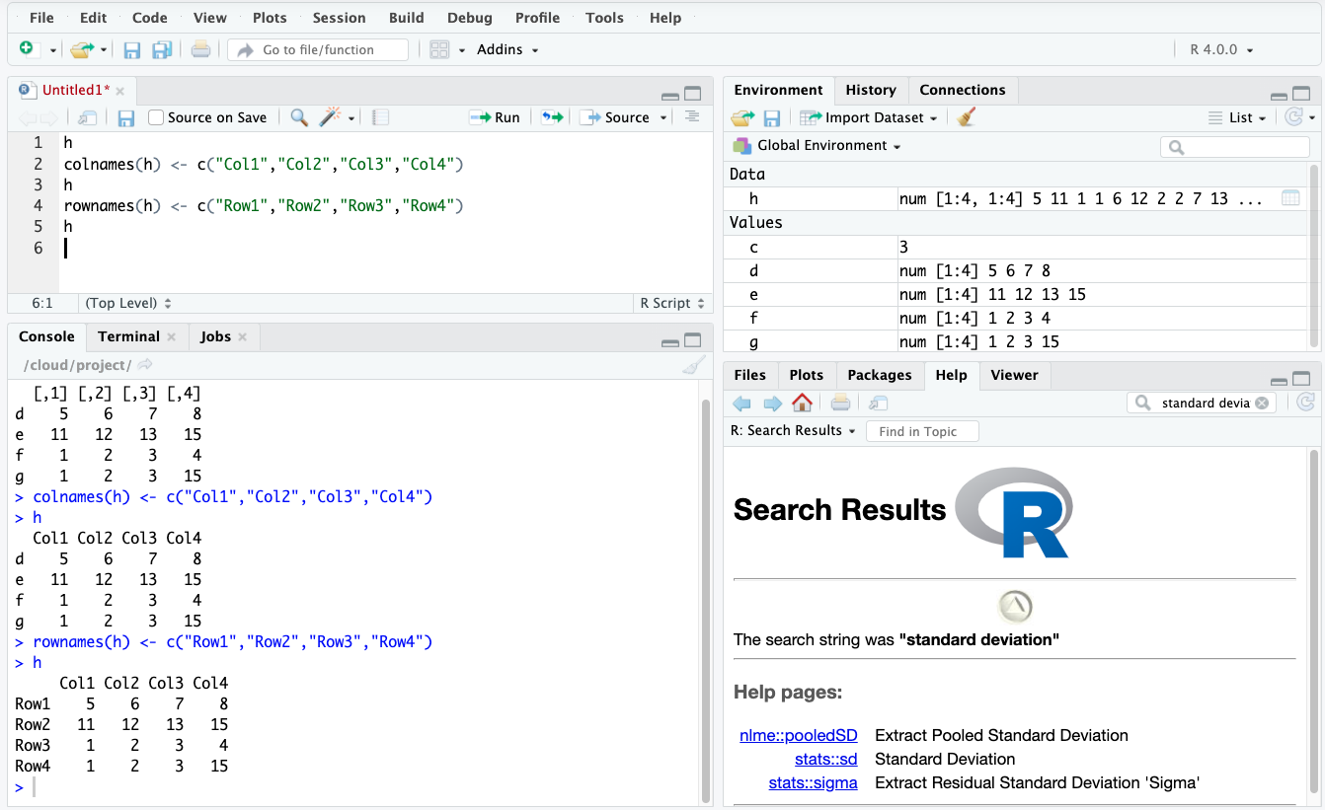

Slide 26
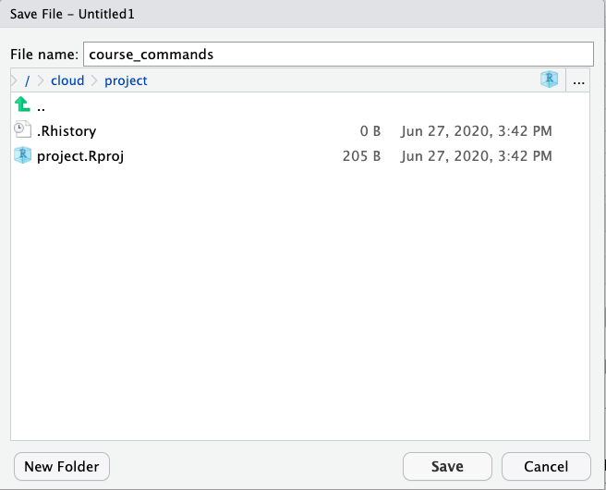
Save your amazing work!

Slide 27
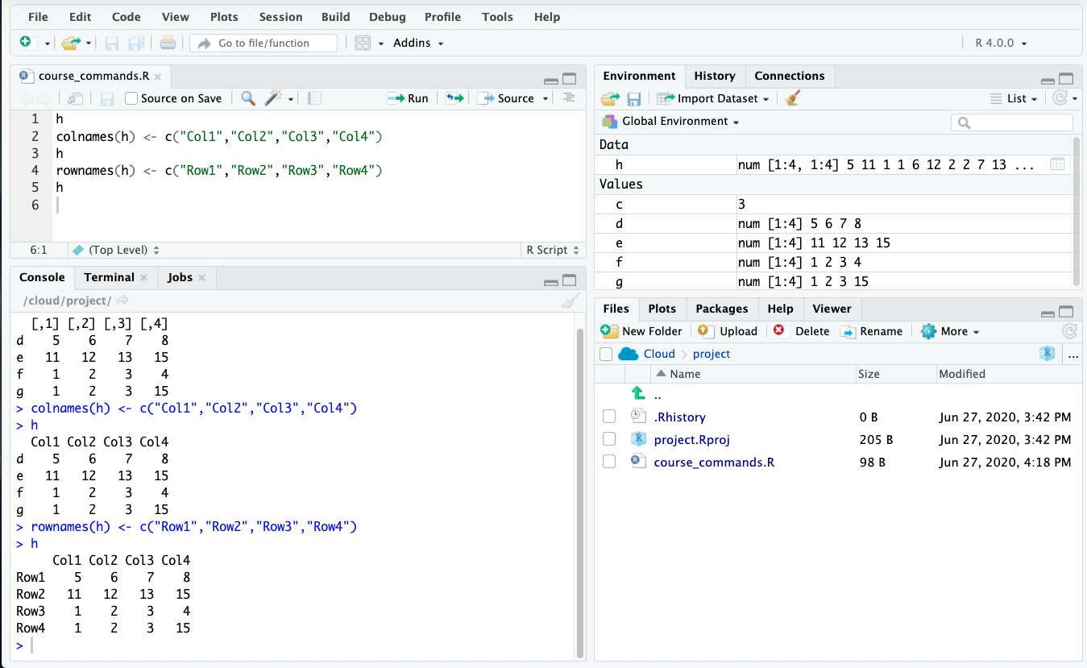

Slide 28
Data wrangling!
We could use base R
Or the tidyverse collection of packages
Specifically designed for data science

Slide 29
What is a package
A collection of R functions, complied code and data
Saved in a directory called “library”
Can be turned on and off
Made by different people commands may clash
Would also be very slow to load everything every time

Slide 30
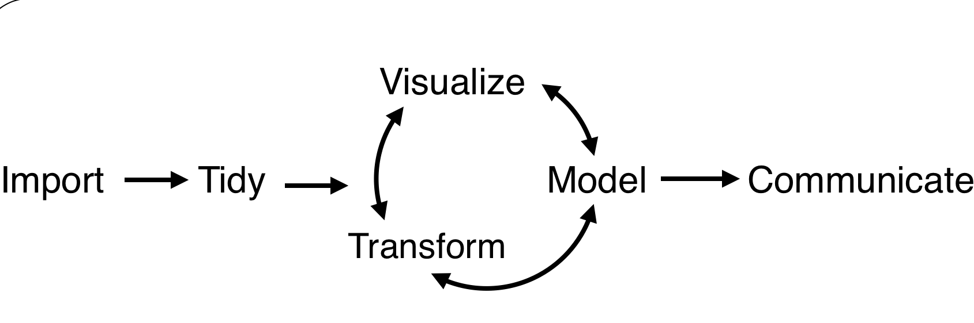
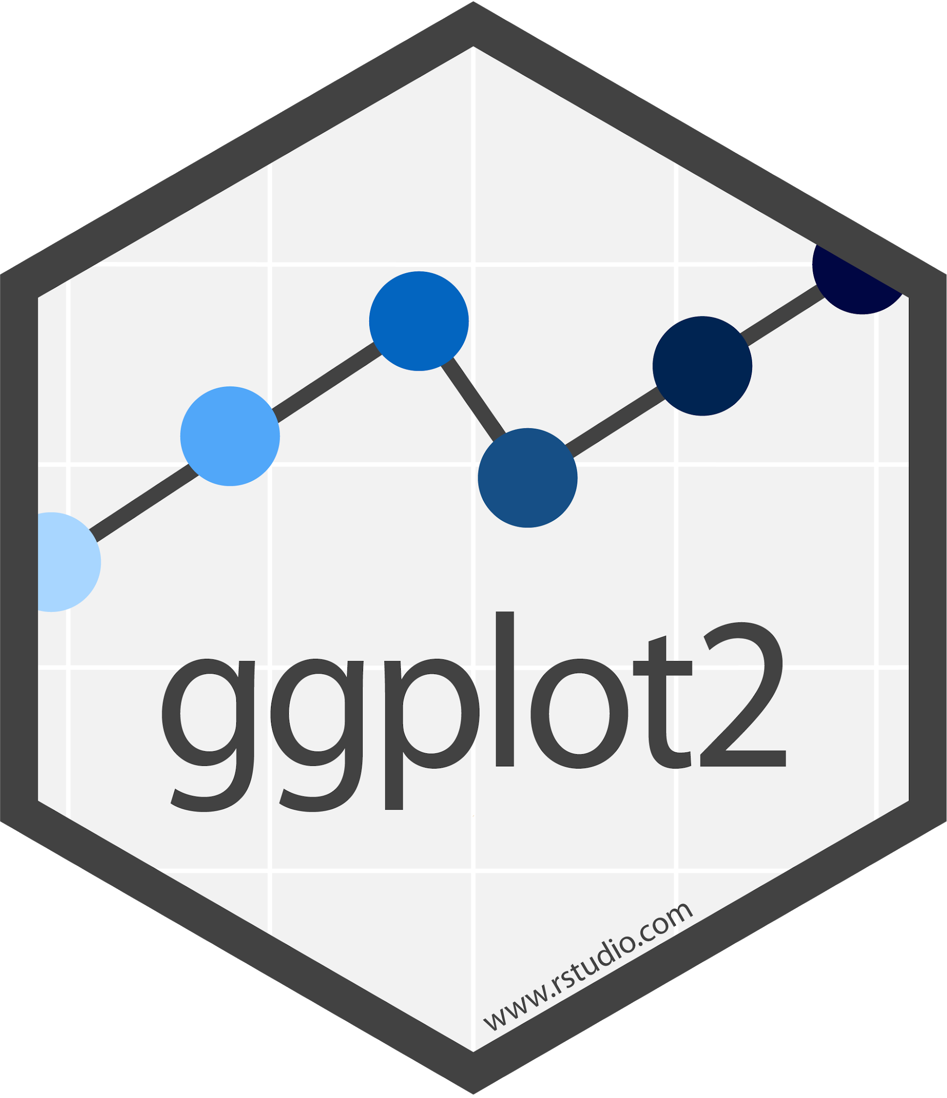








Tidyverse
First time install: install.packages("tidyverse")
Turn on package set: library(tidyverse)

Slide 31
Let’s get started!
Click on the Intro_R.Rmd
The first dataset we will use is from the Mayo Clinic trial in primary biliary cirrhosis (PBC) of the liver
It is found within the survival package

Slide 32
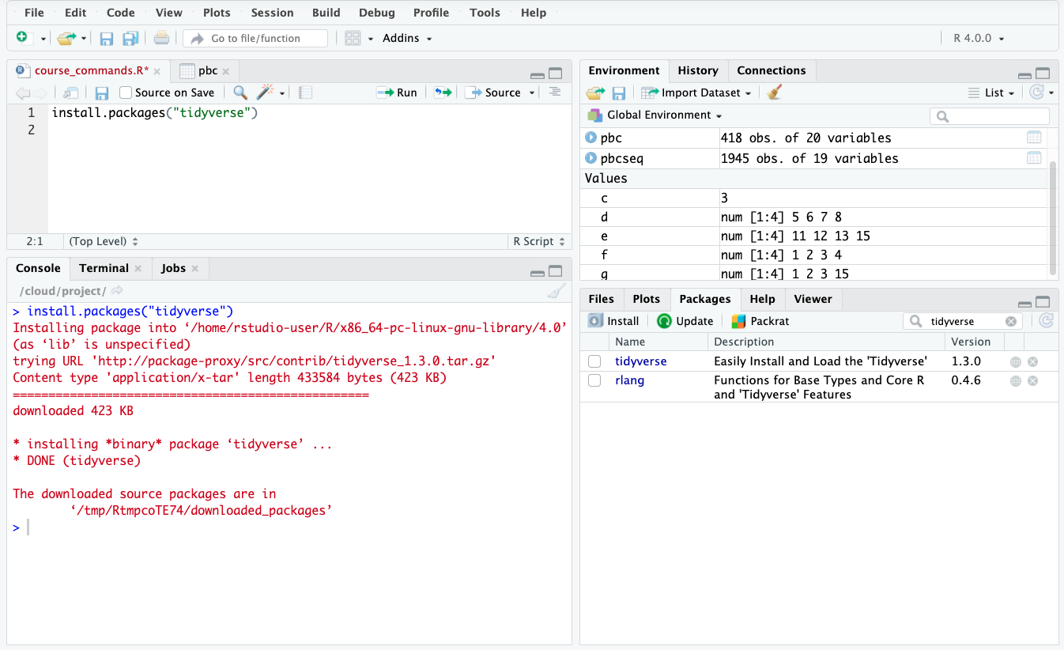
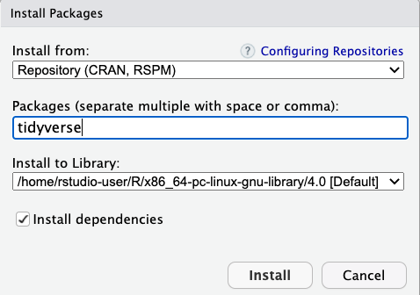
Install like this
Or like this

Slide 33
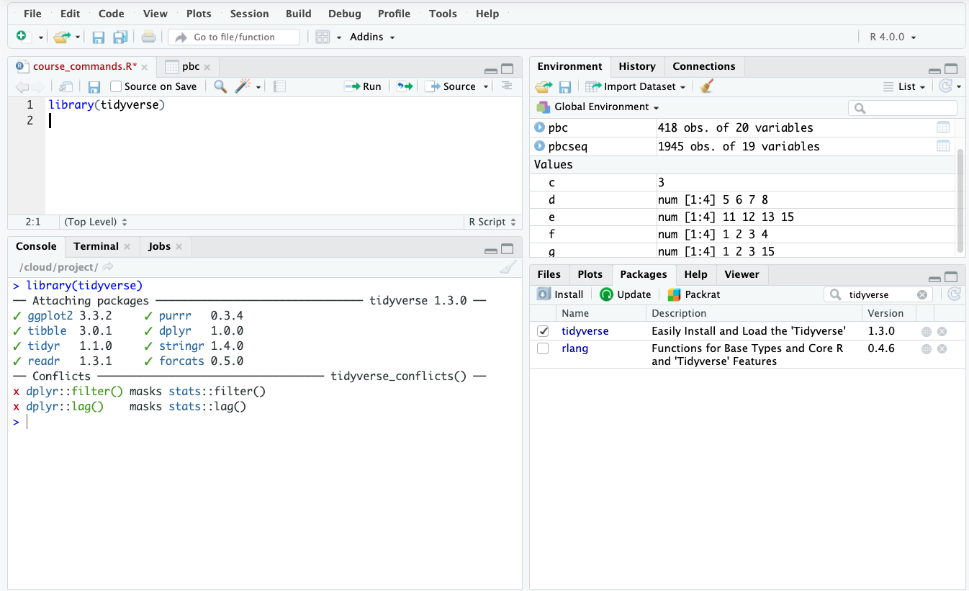
This
OR this
Notes:
install.packages("devtools")
devtools::install_github("tidyverse/tidyverse")

Slide 34
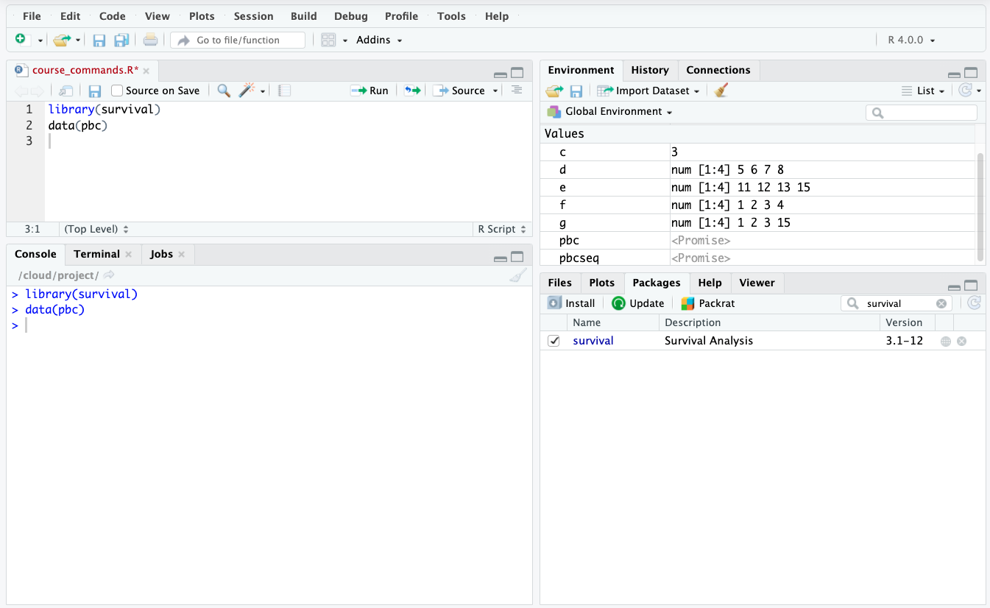
Notes:
Either command line or click on packages

Slide 35
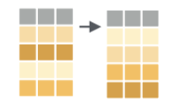
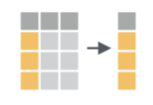
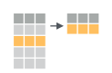
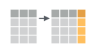
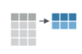
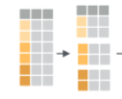
dplyr: Transform your data
arrange()
select()
filter()
mutate()
group_by()
summarize()
Basic structure:
dpylr function(data, specifics)
Example:
arrange(pbc, age)
Notes:
pbc %>%
select(sort(names(.)))
pbc <- pbc %>% mutate(
age_bin = case_when(
age <= 45 ~ "Adult",
age >45 & age <= 60 ~ "Middle_aged",
age >60 ~ "Old"))
We can also use .after=age

Slide 36
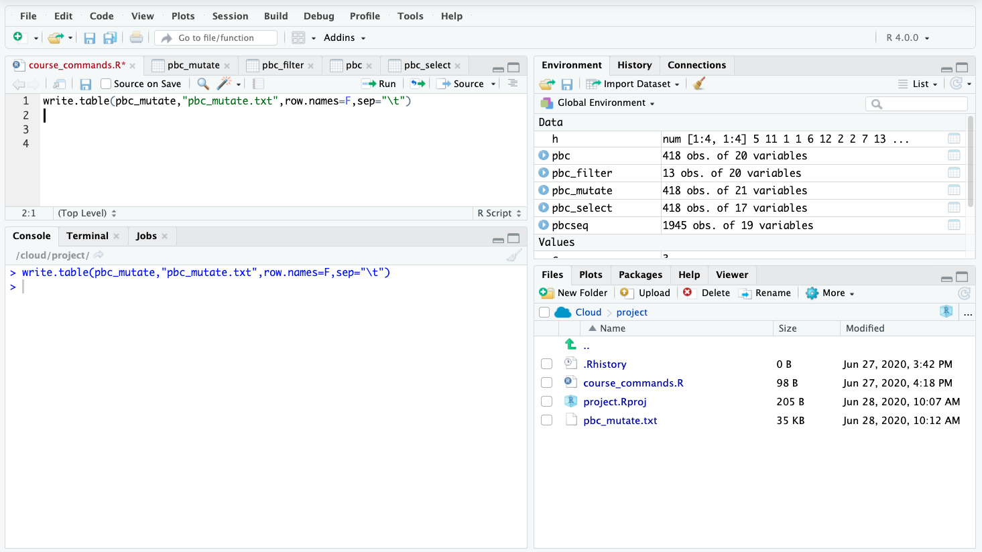
Save a table as a file
write.table(pbc_mutate,"pbc_mutate.txt",row.names=F,sep="\t")

Slide 37
Pipes!
Let’s say I want to know the average age for males versus females I could:
group_by_sex <- group_by(pbc,sex)
ave_age_sex <-summarise(group_by_sex, mean = mean(age))
OR.
Use a pipe! %>%
This allows sequential operations to be done on the same dataset:
pbc_final <- pbc %>% group_by(sex) %>% summarise(new_col = mean(age))
View(pbc_final)
Keyboard Shortcut:
PC:Ctrl+Shift+M
Mac:Cmd+Shift+M
Notes:
summarise()` ungrouping output (override with `.groups` argument) This is just to tell you the data fed into the summary was grouped

Slide 38
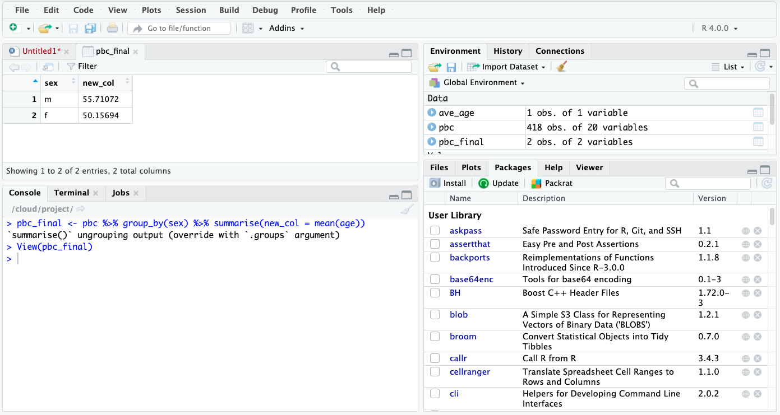
Notes:
summarise()` ungrouping output (override with `.groups` argument) This is just to tell you the data fed into the summary was grouped

Slide 39

Data visualization in R

Slide 40
ggplot2: Visualize your data
Easy out of box formatting
Handles complex data quickly
Default options are aesthetically pleasing
Layering system = add complexity as you go
Automatic scaling generally works well
Great documentation and support

Slide 41
ggplot2: Visualize your data
What you need:
1. A data object
2. Aesthetic mappings (aes): how variables in the data are assigned to visual properties
x- and y-direction
shapes, colors, lines
3. A geometry object (geom): the type of plot
Basic structure:
ggplot(data, aes(x=variable)) + geom_type()
Example:
ggplot(pbc, aes(x=sex)) + geom_bar()

Slide 42
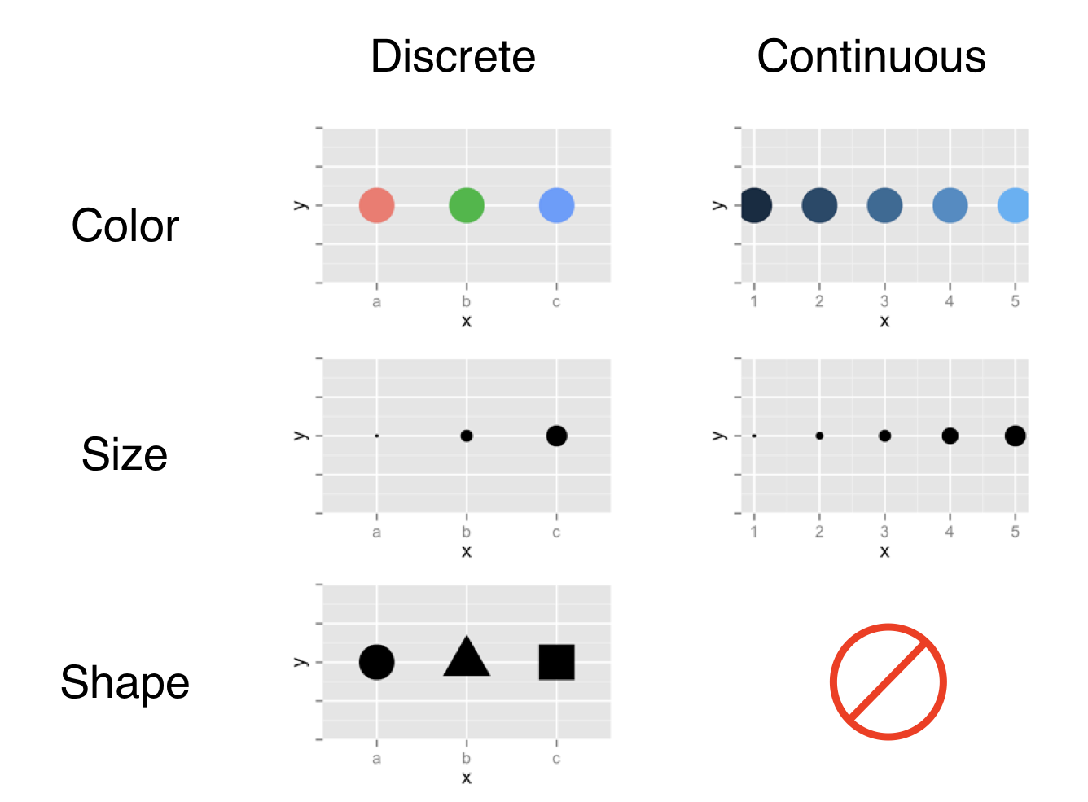
Aesthetic mapping options

Slide 43
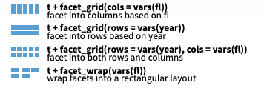

ggplot2:Faceting
Divide a plot into subplots based on one or more discrete variable
Can be used with a variety of plot types
There are a couple of facet flavors
We will use facet wrap

Slide 44

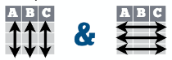
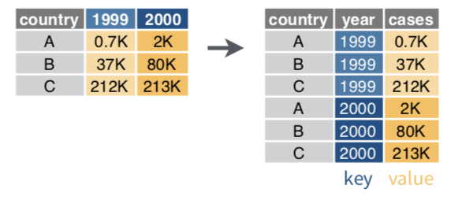
tidr:gather
Typically, each variable is in its own column and each observation/case is its own row
Transform data from wide to long format
gather(data, key, value)
Moves column names into a key column, gathering the column values into a single value column
Notes:
Have note on opposite of gather

Slide 45
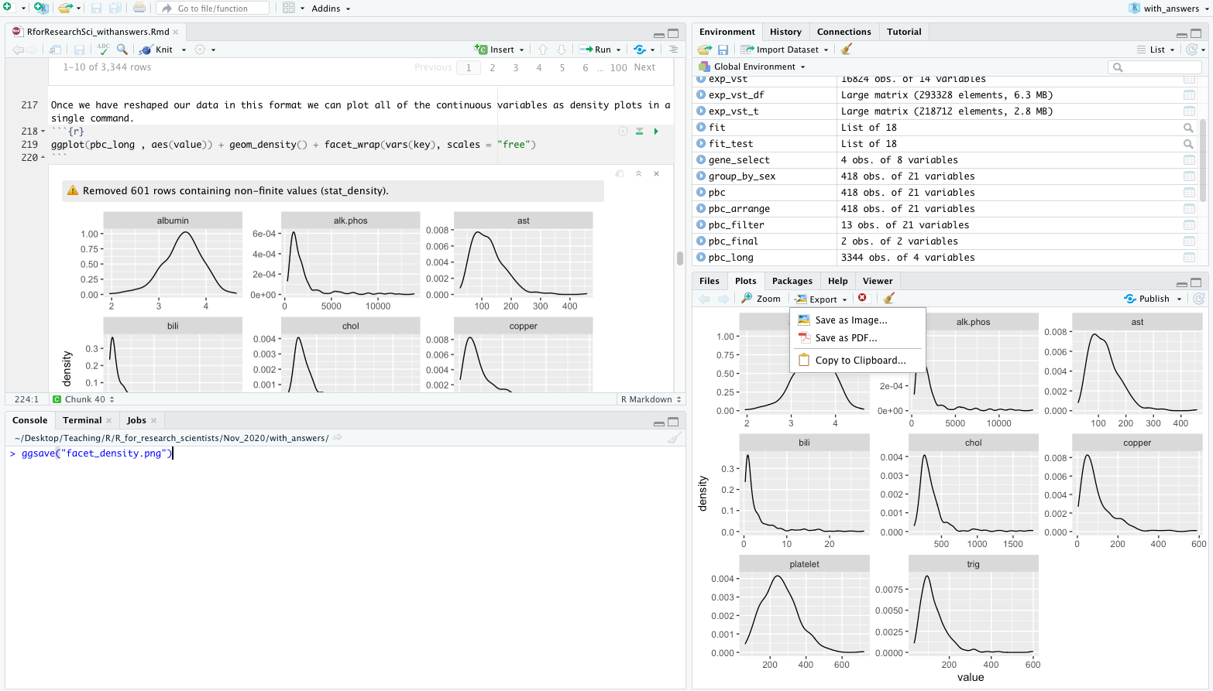
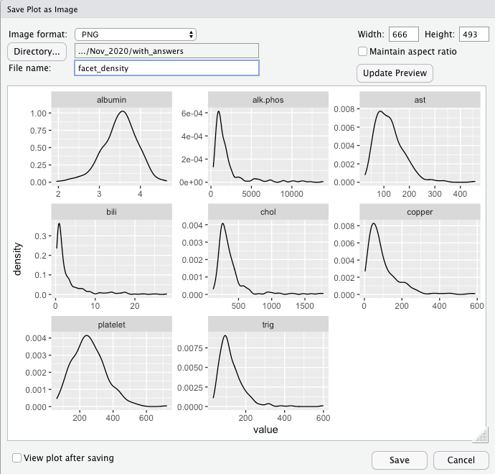
Saving your beautiful graph!
ggsave(“facet_density.png")
OR SEE BELOW!

Slide 46
Transferring to your local R instance
Select all the files in the workspace
Click more on the lower right panel
Click export
Click download
Unzip this file on your local computer
Open the folder and click on the file ending in “.Rproj”
This will automatically open Rstudio with all of the files needed
Once in Rstudio click on the file ending in “.Rmd” for the notebook
You will need to install all of the packages ahead of time
install.packages("tidyverse")
install.packages("ggfortify")
install.packages("plotly")
install.packages("ggThemeAssist")

Slide 47
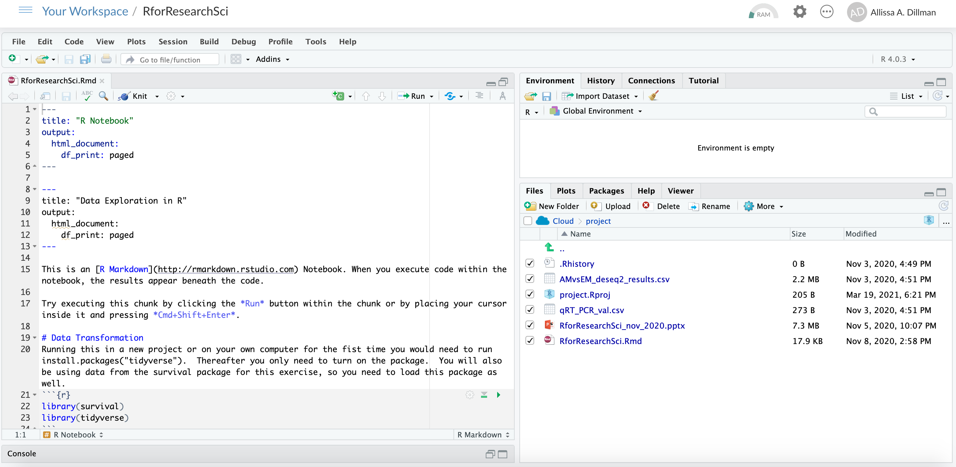
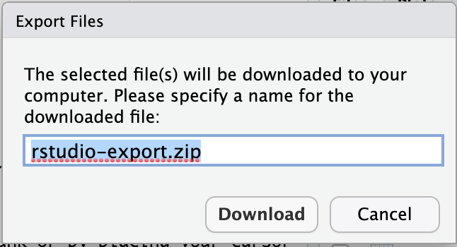
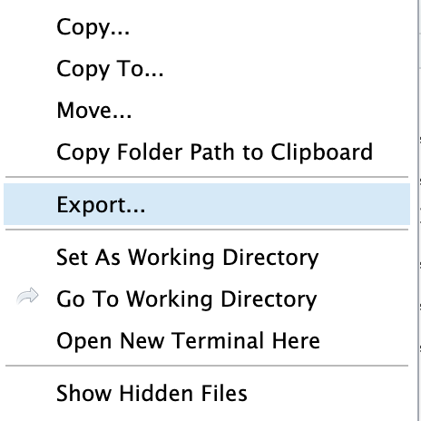
2
4
1
3

Slide 48
Extra Bits

Slide 49
Common biodata visualizations
ggfortify: a ggplot extension for making PCA, survival curves, clustering and more
pheatmap: a package for making nice heatmaps
Volcano plots: just need ggplot
Gene selected box plots
Notes:
Save work before this point as R may need to restart before installation finishes

Slide 50
Streaming DEseq2 normalized counts from GEO to R
We will load the Deseq2 normalized counts table
Data will be obtained from the gene expression omnibus : https://www.ncbi.nlm.nih.gov/geo/
RNAseq of the developing mouse cerebral cortex
3 Adult, 4 embryonic brains
vst <-read_tsv("ftp://ftp.ncbi.nlm.nih.gov/geo/series/GSE39nnn/GSE39866/suppl/GSE39866_Mouse.VarianceStabilized.Datagene.txt.gz")
View(vst)

Slide 51

Volcano Plot

Slide 52
Loading DEseq2 results into R
The data has already been uploaded to the shared workspace
This is from the same dataset of embryonic and adult mouse brains
This is differential expression results created using the DEseq2 package in R
Click the upload button
Click “Choose File”
We will need to find where the file lives on your computer
Default: found in the download folder
Click “ok”
exp <- read_csv("AMvsEM_deseq2_results.csv")
exp

Slide 53
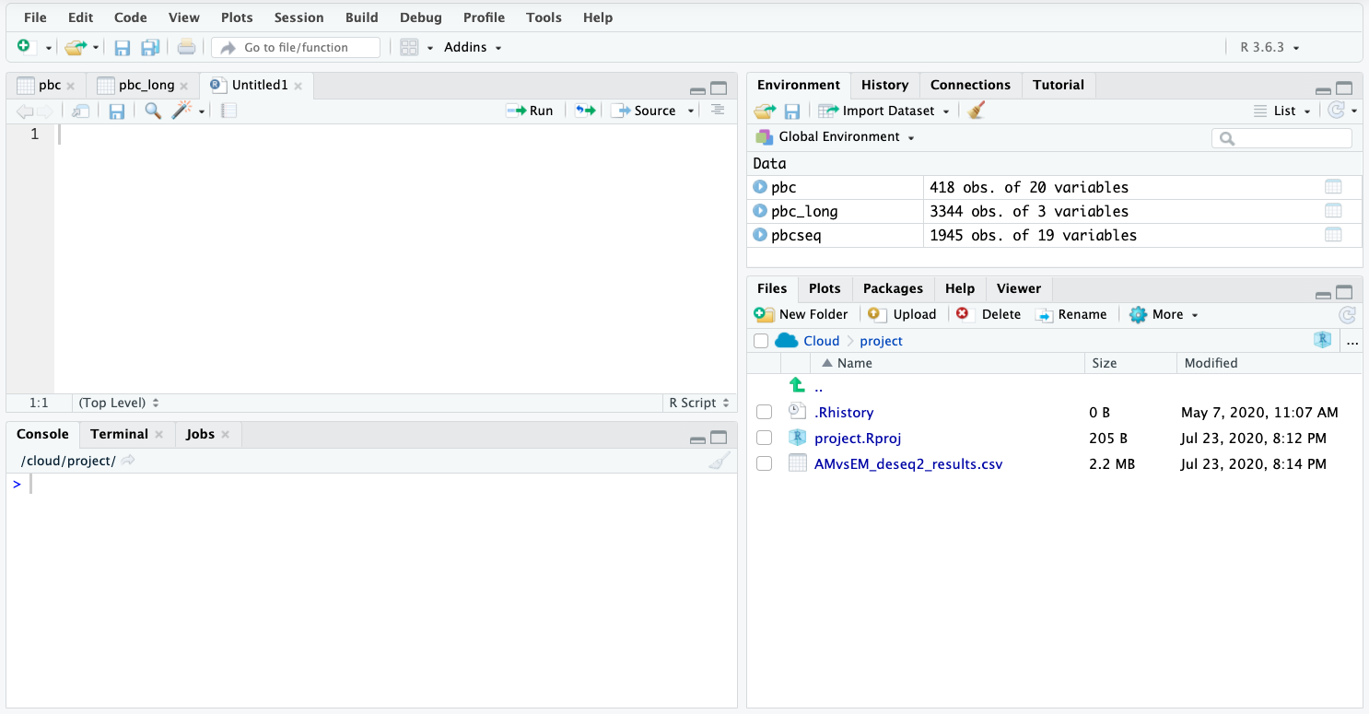
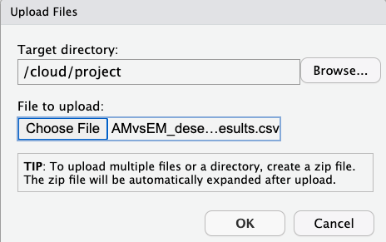

Slide 54
Making an interactive plot!

Slide 55
Interactive Volcano with Plotly
install.packages("plotly")
library(plotly)
plot_ly(data = exp, x = ~log2FoldChange, y = ~-log10(padj), color=~log10(baseMean), type = 'scatter', mode='markers', text= ~gene_id)

Slide 56
Interactive plot customization!

Slide 57
Interactive plot customization with ggThemeAssist
install.packages("ggThemeAssist")
library(ggThemeAssist)
ggplot(pbc, aes(x= sex, y=age)) + geom_boxplot()
Highlight this code in your Rscript
Go to Addins and select ggplot Theme assist

Slide 58
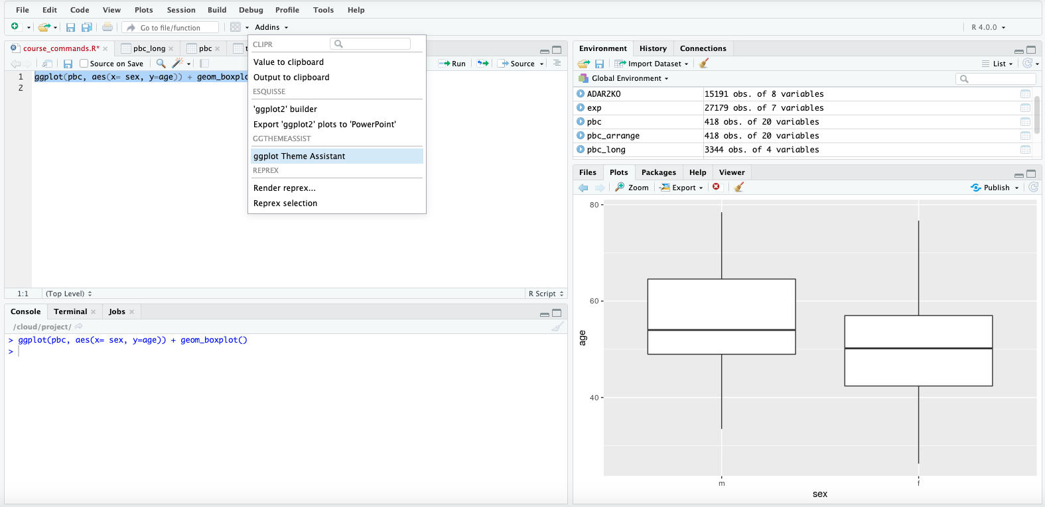
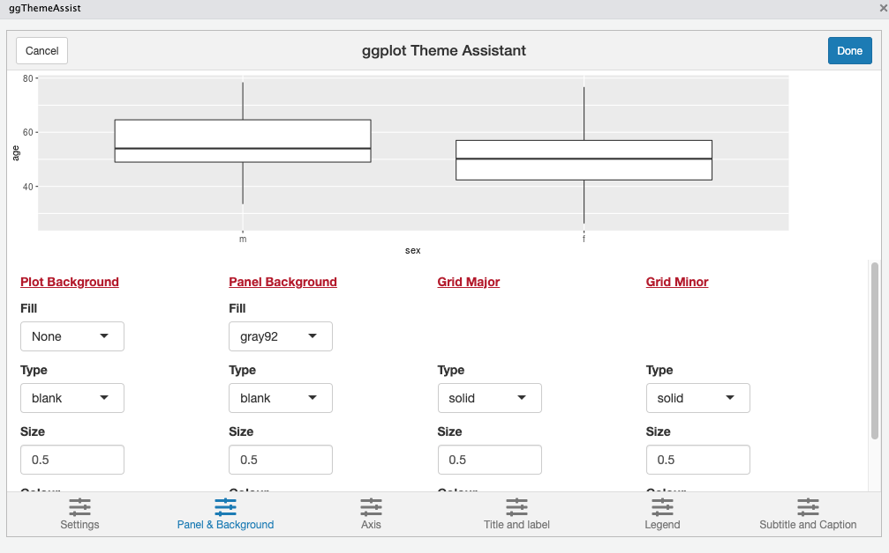

Slide 59
Interactive plot customization with ggThemeAssist
Select the Panel & Background tab at the bottom
In the Panel Background column choose None for the fill drop-down
Select the Axis tab at the bottom
In the Axis line column choose Solid for the type drop-down
Click Done
The package will modify your code in the Rscript

Slide 60
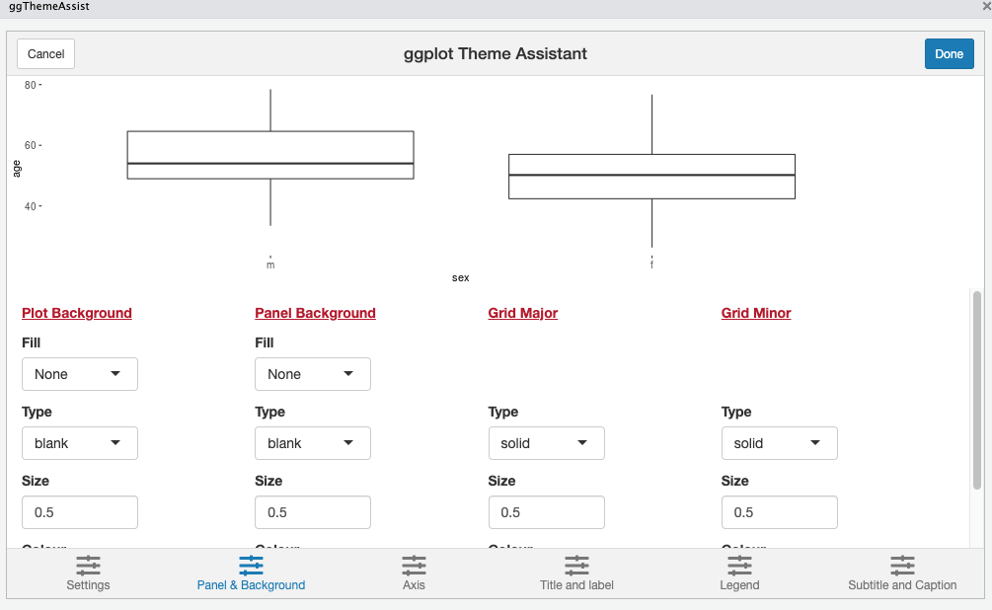
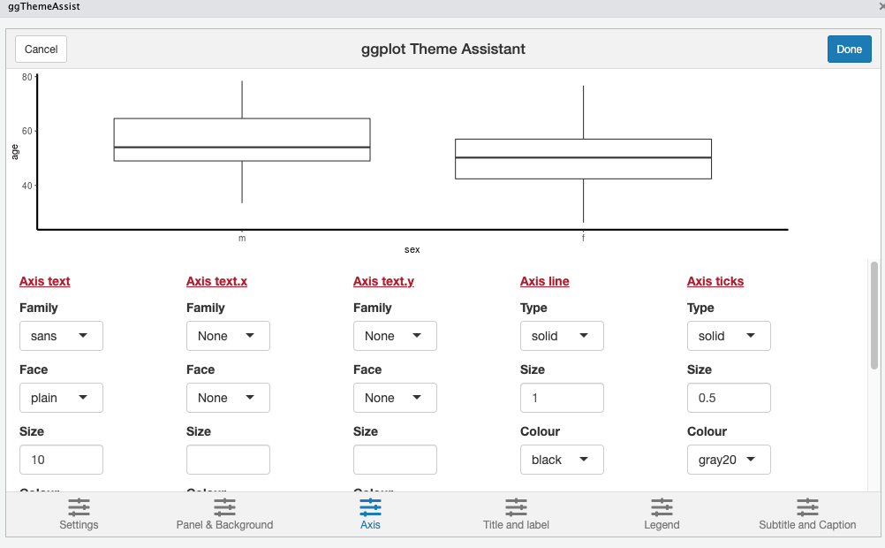
ggplot(pbc, aes(x= sex, y=age)) + geom_boxplot() +
theme(axis.line = element_line(linetype = "solid"), panel.background = element_rect(fill = NA))

